Slide 1
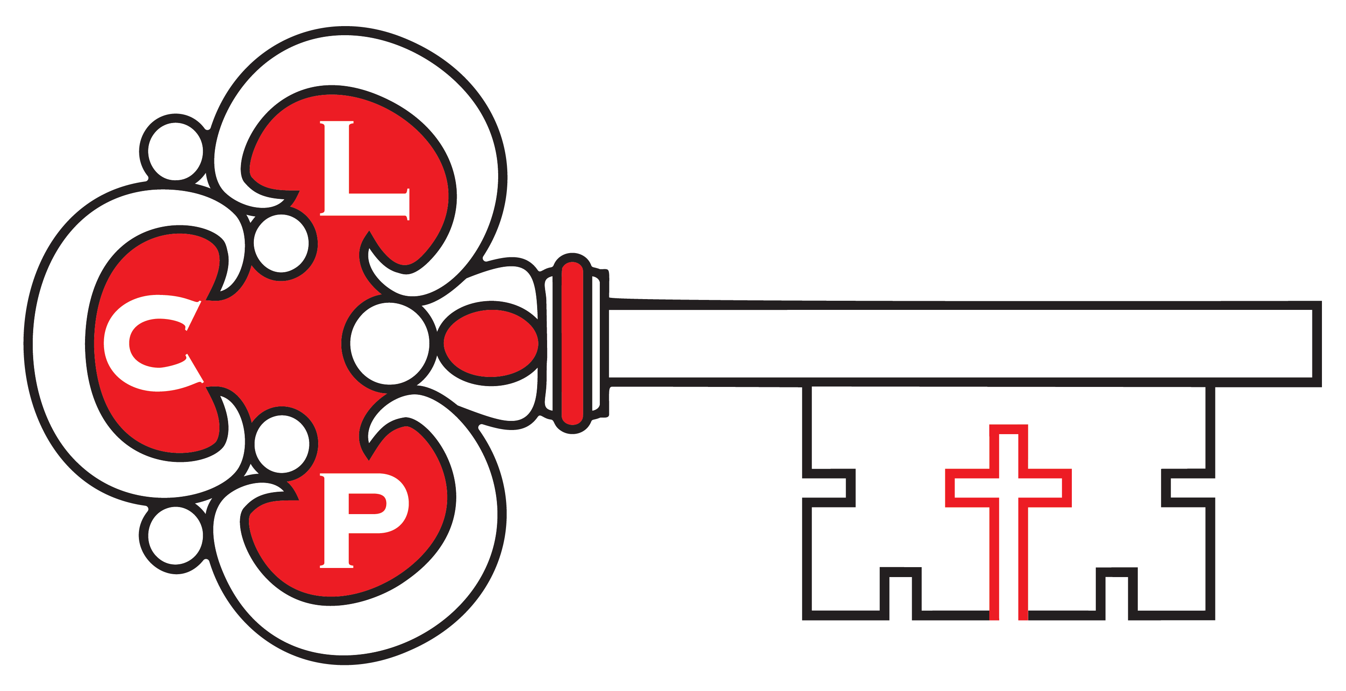
Coaching
Groups vs Teams
Province V Leadership Coaching Project

Slide 2
Groups
A group is characterized by:
• Not committed to a shared vision
• Roles apply outside the group
• Common interests but no group goals
• Each individual is responsible for results outside the group
• Peer sharing and learning

Slide 3
Teams
A team is characterized by:
• Commitment to a shared vision
• Clear roles and responsibilities within the team
• Definable team goals, individual goals aligned with team goals
• Shared responsibility for results of the team
• Synergistic collaboration and creation

Slide 4
Which do we want to be?
Team
Shared Vision
Clear Roles and responsibilities
Clear Goals
Team Responsible
Collaboration to create and learning
Group
*Or no vision? What is our mission statement?
*Roles are outside group
*Common interest no goals
*Individual Responsibility
*Peer sharing and learning

Slide 5
Leadership Coaching Project Province V http://www.provincev.org/lcp

