Slide 1
Vestry 105:Finance & Stewardship Jump-Start
Brian Barnhart – Treasurer Holy Communion
Desiree Brattin – Canon for Finance & Administration
Rev. Canon Whitney Rice - Canon for Evangelism & Discipleship Development

Slide 2
Agenda
Ministry of a Treasurer
Treasurer Duty: Internal Congregation Stakeholders
Treasurer Duty: External Stakeholders
A Year in the Life of a Treasurer
Resources Available to Treasurers
Theology of Stewardship
Wrap up

Slide 3
Treasurer Duty: Internal Congregation Stakeholders
Treasurer Responsibility
Key Problems to Solve
Reporting
Are we OK? Are we tracking well to our budget? Do we have enough cash?
Bookkeeping
Are checks getting written and pledges being received? Are the books in order?
Forecasting
How are we going to end the year?
Budgeting
What is next year going to look like financially?
Stewardship Support
Do we need to make any specific asks this campaign season?
Risk Considerations
Do we have good Internal Controls? Are our pledges too concentrated on too few members?

Slide 4
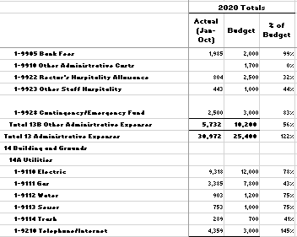
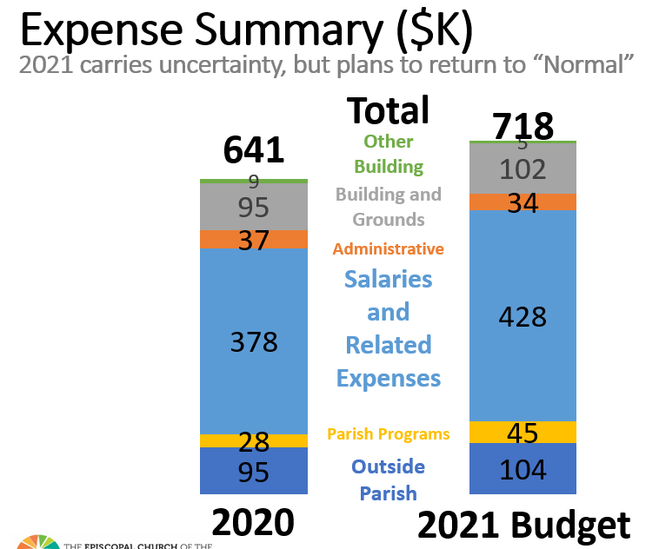
Treasurer Duty: Internal Congregation Stakeholders Cont
Reporting Level of Detail
Recommendations
Automation - Encourage online giving to smooth donation trends and save efforts on processing and reminders
Stewardship - Incorporate multiple views
Annual Campaign
Capital Campaign
Planned Giving
Special Designation Giving
Alternative Income - Consider non-stewardship options such as rental income or grants
Thank you Campaigns – Let donors know they are appreciated, even when not in a Campaign
VS
Less is More: Less granular reporting may better meet your congregation’s needs and will save you time and effort

Slide 5
Treasurer Duty: External Stakeholders
Audits
Required annually by both National and Diocesan Canons. Due into the Diocesan Office by July 1
Why are audits necessary?
Audit guidelines can be found in Chapter VI of the Manual of Business Methods in Church Affairs
Annual Assessment
What is it? Funds to support the mission of the church at the diocesan and national level
Diocesan assessment is a minimum of 12.5% of net disposable budget income following a deduction of $750 and based on the Parochial report (Line A) from the previously completed year
National assessment is 15% of diocesan operating income less a $140,000 exemption
Parochial Reports
What is it and why do congregations file?
Canonical Due Date of March 1 to the Diocese
2020 report changes

Slide 6
Treasurer Duty: External Stakeholders Continued
IRS – Clergy Taxes
Clergy have dual tax status - Considered employees for income tax reporting purposes and self-employed for Social Security and Medicare tax purposes
Housing Allowance – Must be approved in advance by resolution
Church Pension Fund
Clergy Pension Fund – Church employers are required by Canon law to pay pension assessments. Current rate is 18% of cleric’s total assessable compensation
Lay Pension Fund - Mandatory for employees working a minimum of 1,000 hours annually. If a defined benefit plan is selected, the employer contribution shall be not less than 9% of the employee's compensation; if a defined contribution plan is selected, the employer shall contribute not less than 5% of the employee's compensation and match at least 4 %
Church Medical Trust – The Denominational Health Plan (DHP) mandates coverage for eligible employees working a minimum of 1,500 hours annually
Diocesan Financial Support
The Diocese provides various forms of financial support – Diocesan Operating Budget, Church Assistance Endowment Fund Grants, New Ventures in Community Ministry Grants, Continuing Education Grants for clergy and lay employees, COVID Livestreaming Equipment Grants, COVID Church Cleaning Grants, Kelton White Fund Capital Project Loans

Slide 7
A Year in the Life of a Treasurer
Task | Jan | Feb | Mar | Apr | May | Jun | Jul | Aug | Sep | Oct | Nov | Dec
Vestry Reporting and Forecasting
Book keeping and check writing
Budget Preparation
Stewardship Support
Risk Considerations
Submit Parochial report
Confirm Diocesan Assessment
Audit Support
Grant Applications

Slide 8
Resources available for Treasurers
https://www.diocesemo.org/ - Diocese of Missouri website
Manual of Business Methods in Church Affairs - Financial Management, internal Controls, bookkeeping, taxes, discretionary funds, audit guidelines, risk management, records management
The Vestry Handbook
The Vestry Resource Guide
https://www.churchnext.tv/library/what-vestries-need-to-know-about-money/202586/about/
https://www.ecfvp.org/vestry-papers/article/607/basics-of-church-financial-reporting-part-ii
https://www.generalconvention.org/forms-and-instructions - Parochial Report downloadable forms, instructions and online filing
https://www.episcopalfoundation.org/ - Resources on Endowment Management Solutions, Donor Advised Funds, Planned Giving, Capital Campaigns

Slide 9
Resources available for Treasurers Continued
https://www.tens.org/ - The Episcopal Network for Stewardship
https://www.churchlawandtax.com/ - Information on legal, tax, financial, and risk management matters
IRS tax guide for churches and religious organizations pub 1828
Church Pension Group 2021 Federal Reporting Requirements for Episcopal Churches
Church Pension Group 2021 Clergy Tax Return Preparation Guide for 2020 returns
https://www.cpg.org/ - Church Pension Group – Pension, health insurance, property & casualty, payroll services
Clergy Compensation Guidelines
Online giving platforms – Vanco, Tithe.ly, Generosity by Lifeway, Pushpay, SecureGive, E-give USA, Realm
Canon for Finance & Administration – Available for consultation
Other Treasurers – SAME TEAM!!
Recurring Diocesan Treasurer Calls

Slide 10
Theology of Stewardship
God as Giver
Giving as the Sacramental Life
The Biblical Witness
Tithe as a Life-giving Spiritual Practice

